Slide 1
High to Low
Translating Common High Level Operations to Assembly

Slide 2
Motivation
We’ve gotten enough background on Assembly and Architecture.
Now it’s time to dig in and write some code.

Slide 3
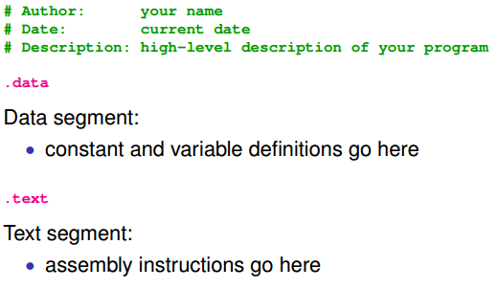
Assembly Program Structure
http://web.engr.oregonstate.edu/~walkiner/cs271-wi13/slides/04-IntroAssembly.pdf

Slide 4
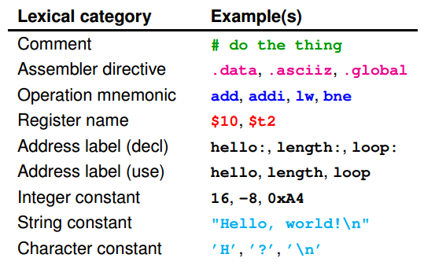
Components of Assembly Code

Slide 5
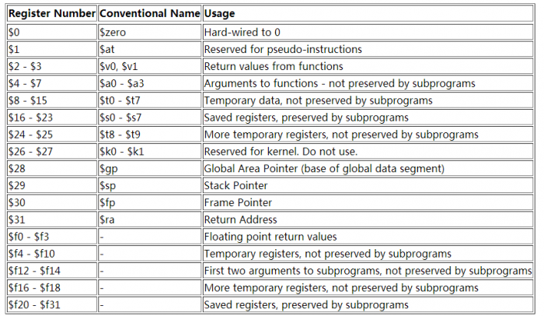
More on Registers

Slide 6
Specialized Registers
The registers in the diagram are accessible to the user.
There are non-accessible registers which the machine uses for computations and state
Ex: HI LO EPC

Slide 7
Functionalities
Arithmetic
Logical
Decisions
Procedures
Character Sets

Slide 8
Shifting
sll – shift left logical
srl – shift right logical
Shifts the bits either to the left or right
a literal number of bits. Fills in with 0’s.
http://cs.middlesex.cc.nj.us/~schatz/csc263/handouts/shift.instrs.html
http://www.cs.umd.edu/class/sum2003/cmsc311/Notes/Mips/bitshift.html

Slide 9
Shifting
sllv – shift left logical by variable # bits
srlv – shift right logical by variable # bits
Can specify number of bits to shift in a
register instead of using a constant.
http://cs.middlesex.cc.nj.us/~schatz/csc263/handouts/shift.instrs.html
http://www.cs.umd.edu/class/sum2003/cmsc311/Notes/Mips/bitshift.html

Slide 10
Shifting
sra – shift right arithmetic
srav – shift right arithmetic by variable #
Arithmetic shifts shift by a constant to
the left and right however it preserves the sign.
http://cs.middlesex.cc.nj.us/~schatz/csc263/handouts/shift.instrs.html
http://www.cs.umd.edu/class/sum2003/cmsc311/Notes/Mips/bitshift.html

Slide 11
Overflow in Arithmetic Ops
Overflow-occurs when the result of a numeric operation needs more bits than are available.
To detect overflow, what would be needed?

Slide 12

Overflow
You’re going to need another bit!
In an n-bit space, n+1 bits are needed to detect overflow

Slide 13
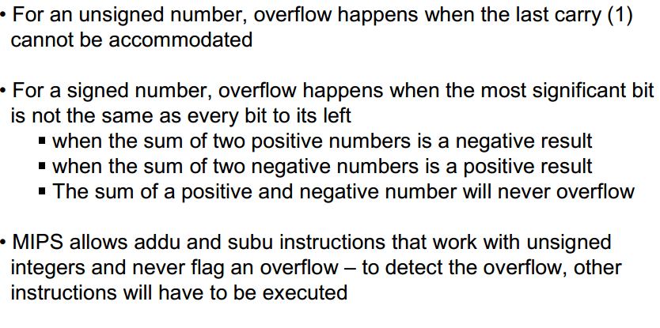
MIPS
http://www.cs.utah.edu/~rajeev/cs3810/slides/3810-08.pdf

Slide 14
MIPS Overflow
CAUSE OVERFLOW EXCEPTION
Overflow detected
add addi sub
These instructions will cause an overflow exception. If exception occurs, other instructions must decode the reason.
DO NOT CAUSE OVERFLOW EXCEPTION
Overflow NOT detected
addu addiu subu
These instructions should be used only with operands that will not cause an overflow
http://courses.cs.vt.edu/~cs2504/spring2007/lectures/lec10.pdf

Slide 15
The “u”
All instructions with a “u” tagged on to the end will not throw an overflow exception.

Slide 16


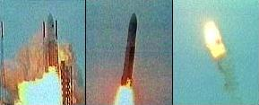
Overflow is bad…..
Routine should have run for 9 seconds. Ran 50 seconds.
Overflow of a conversion from a 64 bit to a 32 bit and caused an exception.
Exception was not caught.
System shut down. *boom*
First Ariane 5 Rocket took 10 years to develop.
Exploded on Launch.
European Space Agency lost $7 Billion

Slide 17
Multiplication
mult $rs, $rt
multu $rw, $rt
Think of the max number of digits we need when we multiply two 3 base ten digits. 6 digits at most

Slide 18
Multiplication
The max number of digits for 32 bit by 32 bit is 64 bits.
Can we store it in a register?

Slide 19
Multiplication
mult $rs, $rt
multu $rw, $rt
Registers are multiplied and stored in the HI and LO registers.
The programmer needs to interpret the result in software.

Slide 20
Loading and Storing
Loading reads data from memory into a register.
Storing writes data from register to memory

Slide 21

Loading from Memory
The code
Loads a value from Memory to a register

Slide 22
Loading to Memory

Slide 23
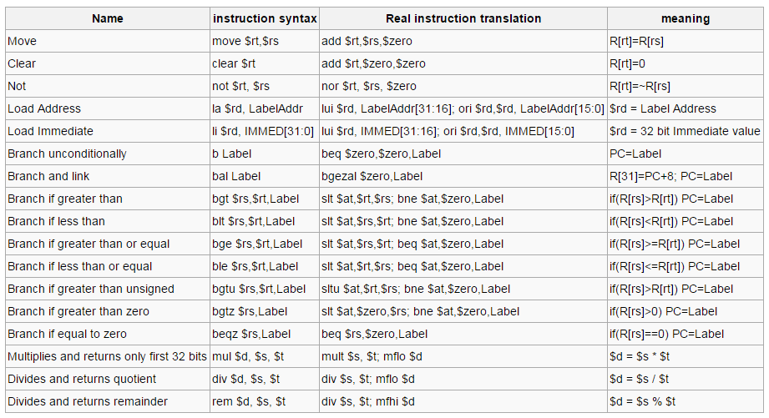
Pseudo Instructions

